Slide 1
Week 8
Peer Assisted Learning

Slide 2
Today’s Session
Programming: OOP!
Today’s Plan:
We’ll quickly go over:
The most essential concepts in OOP, including the difference between classes & objects, fields and methods etc.
Creating Objects
Lastly, we’ll quickly look at compiling & Interpreting in Java, as well as strings in Java ☺.
Note: All code is from Java, since this is the language you will be coding in.
After that, we have some programming exercises for you to go through and complete.

Slide 3
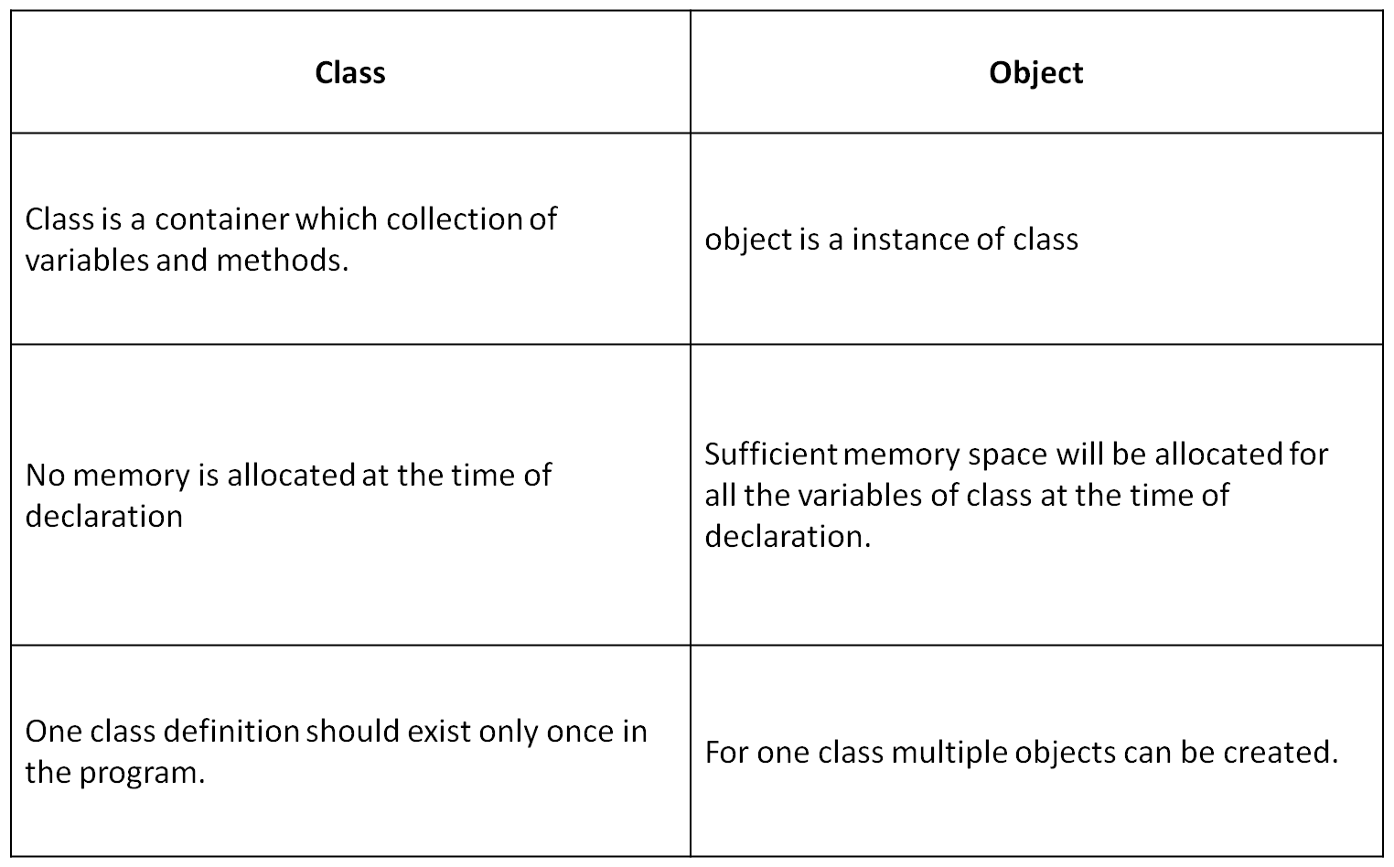
What is the Object-Oriented Paradigm?
A paradigm/model based on the concepts of ‘objects,’ which contain data and certain methods that can act on this data.
In OOP, we have classes and objects.
A class is your blueprint for what an object will be like, and the object is the actual instance of this class.

Slide 4
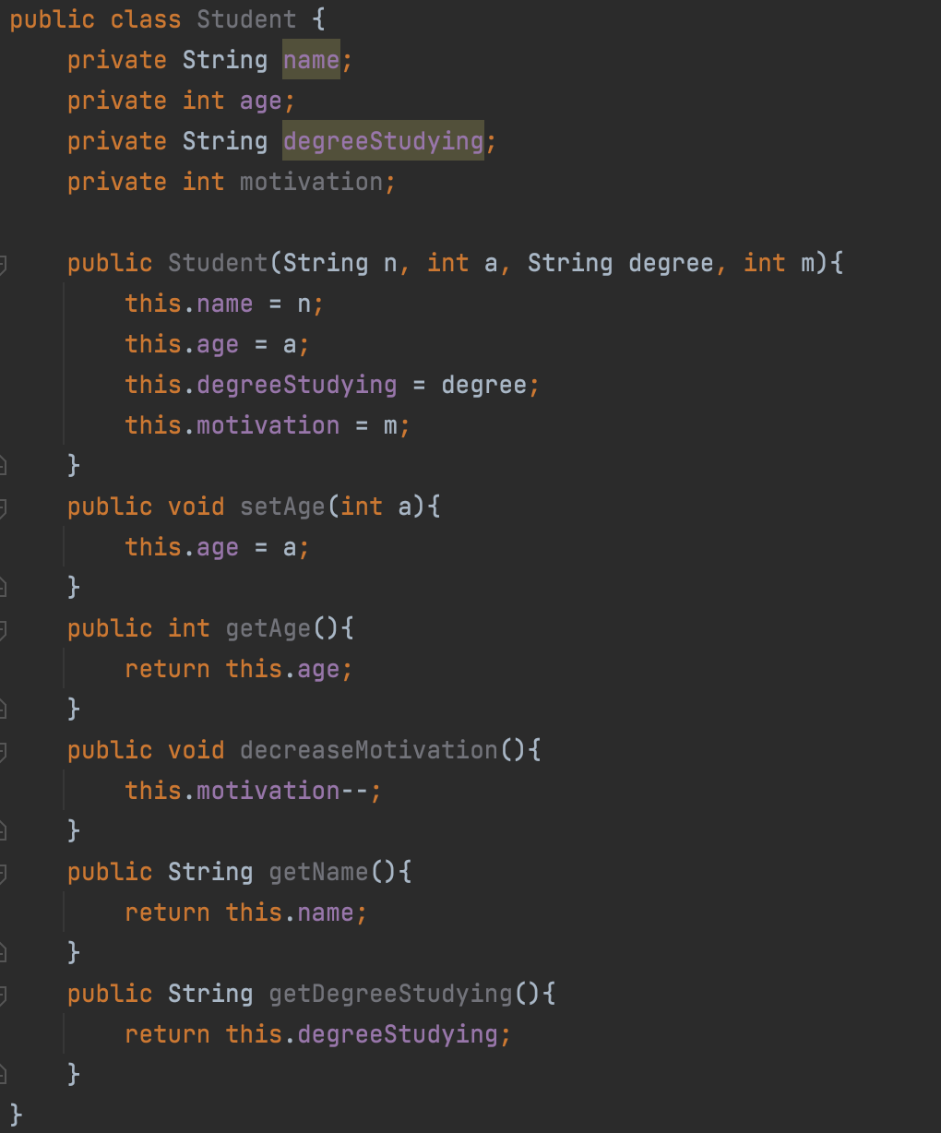
Example Class
In a class, we usually have a:
Constructor, defining how the object is created.
Fields, variables that the store the data belonging to the class.
Methods, which perform actions.
In the class to the right:
What is the constructor?
What are the fields?
What are the methods?
Are any of these accessor/mutator methods?

Slide 5
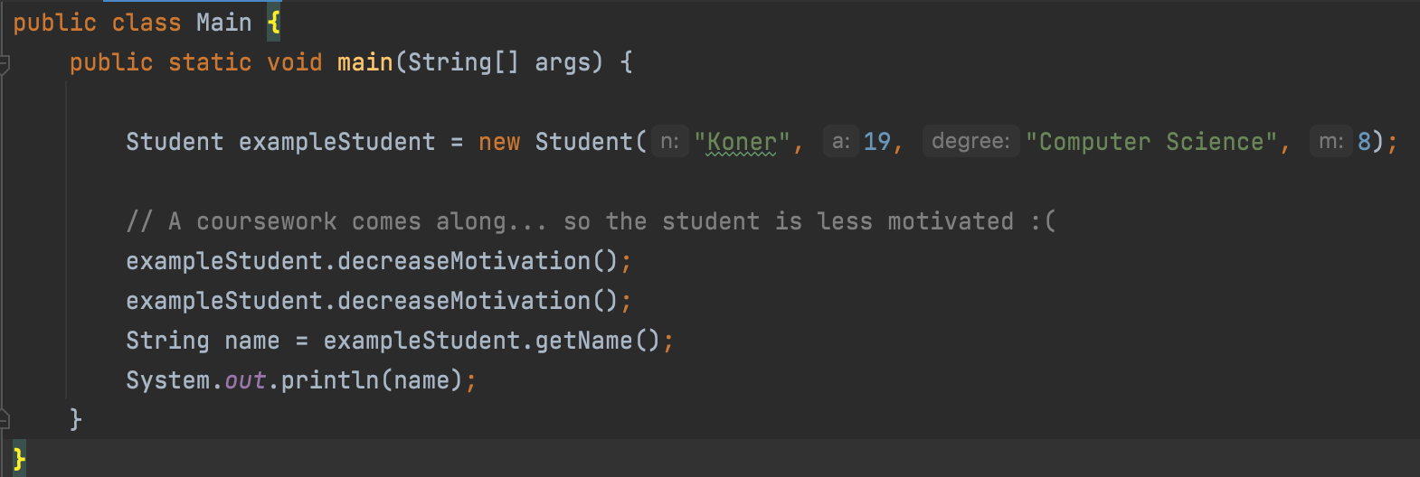
Creating the object
For this example, what would happen if we wrote something like:
System.out.println(exampleStudent.age)
Would we get an error?

Slide 6
Compiling & Interpreting in Java
What is the difference between a compiled language and an interpreted language? Compiles scan the entire program and turns it into machine code, interpreters go line by line.
Java translates a high-level language into machine code by using a combination of interpreting and compiling called just-in-time compilation.
When we execute our program:
The code is compiled into bytecode, which is just code that is processed by another program, usually referred to as a virtual machine, rather than by the actual computer hardware (the processor/CPU).
This code is compiled and executed at runtime by the JVM (Java Virtual Machine).
Advantages: We can find syntax errors before the code runs

Slide 7
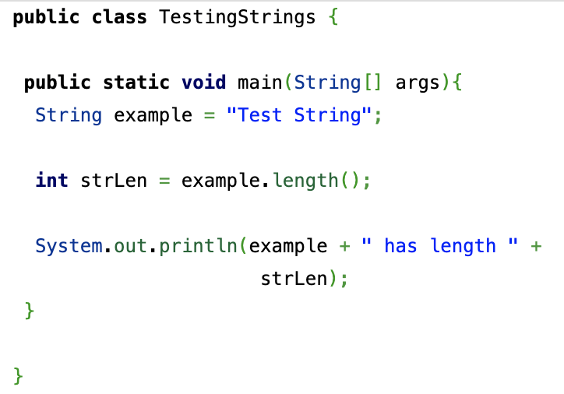
Strings in Java
Strings are objects in Java.
This means that there a bunch of useful methods already available to us that we can use on a string, such as being able to calculate its length, or being able to check if one string matches another:

Slide 8
Most Used String Methods
Strings are objects in Java.
This means that there a bunch of useful methods already available to us that we can use on a string, such as being able to calculate its length, or being able to check if one string matches another:

Slide 9
Activity

